Slide 1
On the Mineshaft Gap
Coordinating the End of Never
Trey Darley · Proper Tools SRL
VulnOptiCON · Luxembourg · 25 September 2026
TLP:CLEAR
- Darley - 2026 -
1
Notes:
⏱ TARGET 0:30 · START AT 0:00
§1 · TITLE
I thought this talk was going to be an easy setup.
A synthesis of my earlier Y2038 work, plus a focused look at one upcoming flag day in Kerberos.
It didn't work out that way.
RUNNING ORDER — target 18:00 spoken in a 25-minute slot.

Slide 2
How I was wrong.
Kerberos was my cleanest example of a 2038 protocol problem, for about a year.
WHAT I SAID
WHAT'S TRUE
Kerberos has a protocol-level 2038 problem.
KerberosTime ::=
GeneralizedTime
YYYYMMDDHHMMSSZ
Nobody corrected or challenged me. 🥺
Not a 32-bit epoch counter. 🙈
The Kerberos protocol is fine.
The problems live where implementations translate
that timestamp into their own native time representation.
TLP:CLEAR
- Darley - 2026 -
2
Notes:
⏱ TARGET 1:45 · START AT 1:05
§2 · HOW I WAS WRONG
For about the past year I used Kerberos as my cleanest example of a 2038-class protocol problem.
The 2038 boundary in Kerberos, beneath the Active Directory identity fabric of nearly every enterprise on earth.
Deterministic and ubiquitous: AD is a monoculture by design.
WHAT I LEARNED
I found out a few days ago, checking whether Microsoft had published any updated guidance, that I was wrong about the layer.
In a year of using that example, nobody corrected or challenged me.
The protocol is fine.
KerberosTime is ASN.1 GeneralizedTime (YYYYMMDDHHMMSSZ), not a 32-bit epoch counter.
The problems appear when implementations turn that timestamp into their own native notion of time.
My coordination argument survived, but the mechanism I'd been describing didn’t.
Sources:
- RFC 4120 (KerberosTime ::= GeneralizedTime).

Slide 3
20370913024805Z
TLP:CLEAR
- Darley - 2026 -
3
Notes:
⏱ TARGET 0:30 · START AT 2:50
§3 · "NEVER" IS A DATE
[HOLD A BEAT]
Active Directory needed some finite representation for 'never expires.’
20-something years ago, Windows developers chose 13 September 2037, 02:48:05 UTC
They constrained this one value to fit inside UNIX 32-bit time, for Linux interoperability.

Slide 4
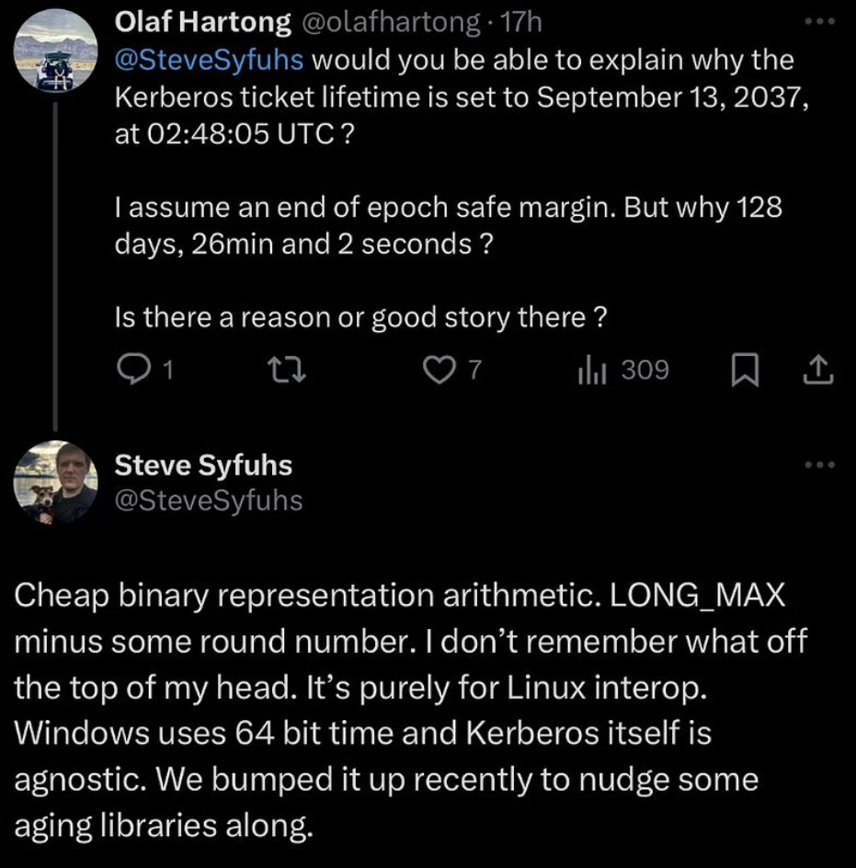
Windows Kerberos' representation of “never”
13 September 2037 02:48:05 UTC
Steve Syfuhs, Microsoft, on X, via Olaf Hartong's FalconForce article
TLP:CLEAR
- Darley - 2026 -
4
Notes:
⏱ TARGET 1:00 · START AT 3:20
§4 · Hartong / Syfuhs X exchange
Native Windows time doesn't have a 2038 problem, Windows' internal clock is 64-bit.
But Windows Kerberos has a 2037 problem.
Why did they choose this odd timestamp?
Sources:
Cleared for quoting by Steve Syfuhs, Microsoft, 22 Sep 2026: "native Windows time will never have a 2038 problem"; expiry "uses a specific value stored in the directory that is completely controlled by Windows".
Cf. public X reply to Olaf Hartong, reproduced in Hartong's FalconForce post "Detection engineering rabbit holes – parsing ASN.1 packets in KQL."

Slide 5
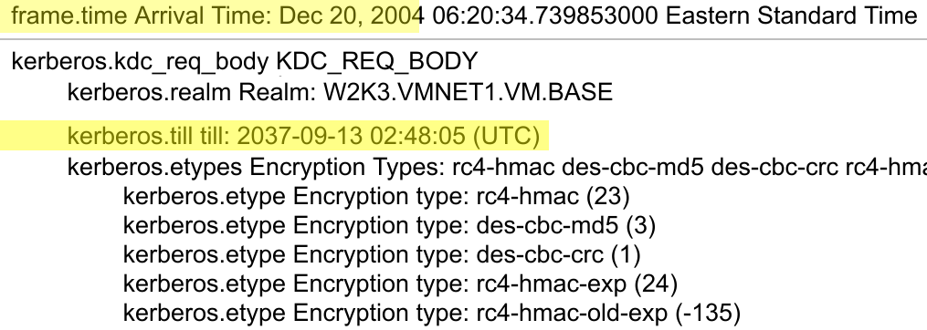
Hiding in plain sight
TGS-REQ captured 20 Dec 2004, domain W2K3
(Packet decode: EventHelix, eventhelix.com/RealtimeMantra/Networking/ldap/details/8.htm)
Pre-22H2 Windows clients ask for tickets valid until 13 September 2037.
Chosen to fit inside Unix 32-bit time, for interoperability.
TLP:CLEAR
- Darley - 2026 -
5
Notes:
⏱ TARGET 0:45 · START AT 4:20
§5 · HIDING IN PLAIN SIGHT
For twenty-something years Windows clients have asked the KDC for tickets valid until 13 September 2037, 02:48:05.
Pre-Windows 11 22H2 (March 2023 update) clients still do.
That's 'never expires', on the wire.
Almost nobody asks why.
Sources:
EventHelix packet decodes, 'Windows 2003 LDAP/Kerberos' capture (20 Dec 2004, eventhelix.com/RealtimeMantra/Networking/ldap/details/8.htm) and 'Kerberos' capture frame 1 (16 Aug 2005, eventhelix.com/realtimemantra/networking/kerberos/details/1.htm)
O. Hartong, FalconForce, "Detection engineering rabbit holes – parsing ASN.1 packets in KQL"
R. Broeckelmann, "Kerberos Wireshark Captures: A Windows Login Example," Medium.

Slide 6
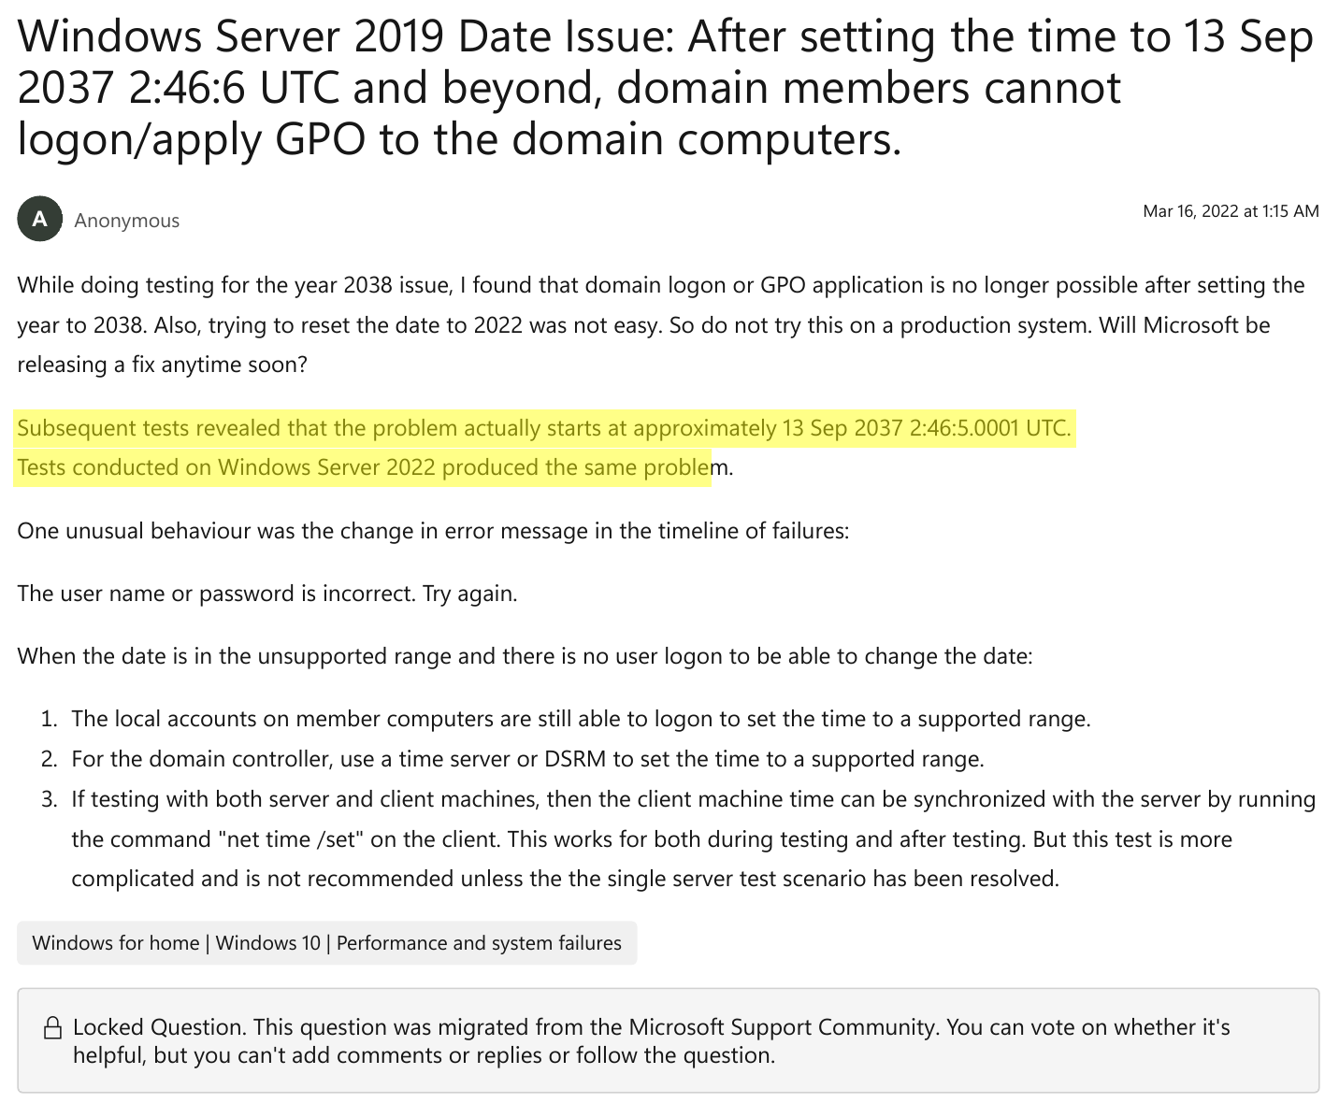
In 2037 “never” stops being in the future
13 Sep 2037 · ~02:48:05 UTC
Server 2019: domain logon and Group Policy fail. Server 2022 reproduces it. (Public report, March 2022.)
“We are quite concerned about the 2037 limit”
— Microsoft, TechCommunity, February 2025
Steve Syfuhs (Microsoft) confirmed to me that this is a real pre-Server 2025 boundary.
Microsoft Q&A · posted Mar 2022 · captured Sep 2026
TLP:CLEAR
- Darley - 2026 -
6
Notes:
⏱ TARGET 1:25 · START AT 5:05 ◀ CHECKPOINT
§6 · THE MISUNDERSTANDING
Here we can see a 2022 forum post about Windows Server 2019, which reports domain logon and Group Policy failing.
This, combined with a misreading of the MIT Kerberos page on Y2038, misled me into thinking that AD has a 2038 issue.
The best AI models I have access to confidently agreed.
THE FINDING
Steve Syfuhs at Microsoft confirmed to me that this is a real pre-Server 2025 boundary.
A 2038-class authentication failure, four months early.
Wherever you find pre-22H2-era clients, that's usually not just because someone was cheap, ignorant, or lazy.
It's an HMI, or it's certified, or the driver only exists for that build.
For XP, Windows 7, and as far as I can tell Windows 10, there is no patch — the change to 2100 shipped in Windows 11 22H2.
Those clients emit this date themselves, so upgrading the domain controllers alone doesn't obviously remove the dependency.
For affected legacy clients, remediation may require upgrade, replacement, or isolation.
In some industrial estates, remediating endpoints still exhibiting this failure mode may in fact be a programme rather than a patch.
Who in the room is already looking at this? (show of hands)
Sources:
Microsoft Q&A, "Windows Server 2019 Date Issue…" (Mar 2022; migrated, locked)
M. Bernstein, Microsoft Tech Community, "Server 2025 Domain Join Error ASN.1," 21 Feb 2025.

Slide 7
Moving “never”: 2037 → 2100
“Native Windows time will never have a 2038 problem.” — Steve Syfuhs, Microsoft, Sep 2026
“Your intuition is correct: we are quite concerned about the 2037 limit, which is not very far away. For accounts with no password expiry, we moved the Kerberos expiry out to 2100, so that our products will continue working past 2037. But some devices do not handle dates properly past 2037.
Our recommendation would be for Cisco and other vendors to update their software to be able to handle dates past 2037 properly -- for the same reason, because 2037 is not so far away. I'm not sure I would call this a ping-pong game -- we all have to work together to handle the 32-bit date limit.” — Michael Bernstein, Microsoft, Feb 2025
2034
2037
2038
2100
2106
≈
Server 2025 extended support ends
Old “never”
(pre-2025)
Signed 32-bit time_t ends
New “never”
(Win 11 22H2+, Server 2025)
Unsigned 32-bit ends
→
2100 fits unsigned 32-bit,
overflows signed time_t
TLP:CLEAR
- Darley - 2026 -
7
Notes:
⏱ TARGET 1:15 · START AT 6:30
§7 · MOVING "NEVER"
Bernstein, Microsoft, TechCommunity, 21 Feb 2025: "For accounts with no password expiry, we moved the Kerberos expiry out to 2100, so that our products will continue working past 2037. But some devices do not handle dates properly past 2037."
”Native Windows time will never have a 2038 problem.” (Steve Syfuhs, cleared for quoting.)
2100 is below the unsigned 32-bit Unix-seconds horizon in 2106 — but beyond what a signed 32-bit time_t can represent.
That is exactly what broke downstream implementations.
Deployed infrastructure routinely outlives vendor support.
Microsoft was retiring an interop courtesy that had become a liability.
Sources:
- Bernstein reply (21 Feb 2025); Microsoft Lifecycle — Windows Server 2025, https://techcommunity.microsoft.com/discussions/windowsserverinsiders/server-2025-domain-join-error-asn-1/4351355

Slide 8
The breakage arrived piecemeal
Late 2022
Early 2025
Jul 2025
Mar 2026
Heimdal #1011
Cisco ISE
MIT krb5 list
MIT krb5
Windows tries 9999, settles on 2100. Heimdal’s maintainer: “a year of 2100 will still cause a failure.”
Integration with Server 2025 DCs fails decoding the 2100 value in the AS-REP
32-bit clients cannot authenticate to Server 2025
Commit 7e0e602: “Cap decoding GeneralTime when time_t is 32-bit”
Predicted in public in 2022. As of 22 Sep 2026: fixed upstream; not yet in MIT stable 1.22.2.
TLP:CLEAR
- Darley - 2026 -
8
Notes:
⏱ TARGET 1:15 · START AT 7:45
§8 · DOWNSTREAM
Everyone did the reasonable thing.
Microsoft wouldn't go back to 2037.
Heimdal said 2100 would still break.
Both were right.
And the seam sat there, in public, for two years, until Cisco customers found it in production.
Sources:
- Cisco support case as posted by a customer, Microsoft Q&A, Feb 2025; A. Bouchez, kerberos@mit.edu, 2 Jul 2025; krb5 commit 7e0e602, 23 Mar 2026.
- Heimdal issue #1011, 'KDC: TGS-REQ problem with Windows 11 22H2 client', github.com/heimdal/heimdal/issues/1011 (2022–23).

Slide 9
Same week. Two vendors. Opposite positions.
CISCO SUPPORT CASE
MICROSOFT
as posted by a customer · Feb 2025
TechCommunity · 21 Feb 2025
“the issue is on Microsoft Side”
“Our recommendation would be for Cisco and other vendors to update their software.”
⇄
Workaround: revert the domain controllers to Server 2022.
Roll back the upgrade to preserve compatibility?
TLP:CLEAR
- Darley - 2026 -
9
Notes:
⏱ TARGET 0:50 · START AT 9:00
§9 · SAME WEEK, TWO VENDORS
Cisco: "Roll back a security upgrade to preserve compatibility.”
- Microsoft: "Our recommendation would be for Cisco and other vendors to update their software."
- Both positions are locally defensible.
Sources:
- Microsoft Q&A, "Server 2025 Domain Controllers – Trust relationship issues on workstations after 30 days…" (customer-posted Cisco case, Feb 2025); Bernstein, TechCommunity, 21 Feb 2025.

Slide 10
MIT's fix: just make the error stop
#if SIZEOF_TIME_T == 4
/* ... Clamping the result
* as we do here is not safe ... */
if (memcmp(s,
"20380119031407Z", 15) > 0)
*time_out = (time_t)INT32_MAX;
#endif
“32-bit platforms are increasingly rare, and there [sic] no negative ramifications are known at this time.”
— commit message
Rational triage.
“Rare” depends on what part of the ecosystem you can see.
krb5 commit 7e0e602 · 23 March 2026 · src/lib/krb5/asn.1/asn1_encode.c (heavily abridged)
TLP:CLEAR
- Darley - 2026 -
10
Notes:
⏱ TARGET 1:00 · START AT 9:50
§10 · MIT CLAMPING
Two things about MIT's side.
First, MIT's documentation already tells application developers how to handle dates after 2038.
On systems with enough room, you have to read the timestamp the right way yourself.
So part of the fix lives in every program that uses the krb5 library.
But nobody has a list of those programs, so nobody can check them all.
Second, the fix for 32-bit systems.
When a date arrives that's too big to store, MIT rounds it down to the largest date it can hold: January 2038.
Microsoft's 2100 becomes 2038.
Usually that's harmless, because 2038 is still far enough away to mean "never".
But MIT's own code comment warns that it's not safe if the date ever gets written back out.
The rounded value no longer matches what Microsoft sent.
That's the same kind of mismatch that broke Heimdal in 2022.
The commit message explains the choice: “32-bit systems are increasingly rare, and there are no known negative effects.”
That might be a completely reasonable engineering call.
But "rare" and "no known effects" depend on which part of the ecosystem you can see from where you sit.
Sources:
- krb5 commit 7e0e602, 23 Mar 2026; MIT Kerberos docs, "Year 2038 considerations for uses of krb5_timestamp."
VERIFIED: 22 Sep 2026 (in the tree): the clamp is in master, in k5_asn1_decode_generaltime, and is NOT in the krb5-1.22 branch. Stable remains 1.22.2.

Slide 11
“…we all have to work together to handle the 32-bit date limit.”
— Microsoft, TechCommunity, 21 February 2025
So where's the mechanism?
TLP:CLEAR
- Darley - 2026 -
11
Notes:
⏱ TARGET 0:30 · START AT 10:50
§11 · THE MISSING TERM
Bernstein, same reply, answering a user who called it a ping-pong game between Microsoft and third-party vendors: "I'm not sure I would call this a ping-pong game — we all have to work together to handle the 32-bit date limit."
So where's the mechanism for working together?
Cisco says Microsoft moved too soon; Microsoft says Cisco needs to move.
Nobody is behaving irrationally.
Deferral can be locally rational.
The first mover's cost lands on everyone downstream.
The benefit is spread across the whole ecosystem.
So everyone downstream has a reason to wait, and nobody owns the handover.
A bug tracker isn't a migration plan.

Slide 12
Roadmaps. Tooling. Dates. Public messaging.
Same vendor. Same authentication ecosystem. Same years.
NTLM
Audit
Compatibility features · H2 2026
Off by default · next major release
NTLMv1
Removed · Win11 24H2 / Server 2025
Enforce by default · Oct 2026
RC4 in Kerberos
Audit & prepare
Enforce · 2026
2037 → 2100
no dedicated roadmap · tooling · inventory guidance · staged migration — that I can find
Forum replies, yes. Machinery, no.
TLP:CLEAR
- Darley - 2026 -
12
Notes:
⏱ TARGET 1:15 · START AT 11:20 ◀ CHECKPOINT
§12 · THE CONTROL GROUP
Roadmaps. Tooling. Dates. Public messaging.
But for 2037 → 2100: no dedicated roadmap, tooling, inventory guidance, or staged migration that I can find.
Forum replies, yes. Machinery, no.
Microsoft demonstrably knows how to structure an ecosystem migration — it's running at least three of them right now.
Nobody set out to coordinate this, and it is functioning as an unannounced flag day anyway.
Sources:
Microsoft Windows IT Pro Blog, "Advancing Windows security: Disabling NTLM by default" (Jan 2026)
Microsoft Windows Server Blog, "Beyond RC4 for Windows authentication" (Dec 2025)
Microsoft Learn, "Detect and remediate RC4 usage in Kerberos."

Slide 13
?
OLD
POPULATION
NEW
POPULATION
WHO OWNS THIS?
TLP:CLEAR
- Darley - 2026 -
13
Notes:
⏱ TARGET 1:10 · START AT 12:35
§13 · THE SEAM
- Exposure models tell us what's reachable.
What this case made me realise is that exposure isn't the whole operational problem.
Once remediation begins, risk can move to the boundaries between populations
The dangerous population may be neither the remediated set nor the unremediated set, but the gap between them.
Should coordinability be represented as another term in an exposure model — or is it a property of the transition graph between populations?

Slide 14
2038 is a migration interval
It isn't an instant. It’s an entire problem space.
Feb 2036
Sep 2037
Jan 2038
Nov 2038
NTP era rollover
Windows' historical “never”
Signed 32-bit time_t
GPS week rollover
…and those are merely some of the dates we can already name.
TLP:CLEAR
- Darley - 2026 -
14
Notes:
⏱ TARGET 0:30 · START AT 13:45
§14 · A MIGRATION INTERVAL
2038 isn't an instant.
It's a migration interval.
And those are merely some of the dates we can already name.
There are more than just what’s on this slide.

Slide 15

The mineshaft canary
Don't move the clock. Move “never.”
Windows is the signal generator. Your other kit is the subject.
THOUGHT EXPERIMENT · NOT YET RUN
Server 2022 DC
Server 2025 DC
Test principal:
password expires
normal date
control
normal date
control
1 One Server 2025 DC (plus a 2022 baseline) in a lab domain or isolated site. Prove which KDC answered.
2 Twin test users: identical except password expiry (same enctypes; max password age actually applies).
3 Decrypt one reply per cell (keytab + Wireshark). Confirm 2100 appears only in the probe cell, and that both runs used Kerberos with the same enctype.
4 Point real clients at it: appliances, Unix/GSSAPI, middleware, NAC, VPN.
Test principal:
password never expires
2037 “never”
control
2100
the probe
Same client, same Kerberos path, same enctype. Only one cell crosses 2038.
If only that cell fails, that strongly implicates the post-2038 timestamp.
FAIL (probe cell only) → a post-2038 dependency, reproducible today
PASS → only that this path survived
One dead canary is evidence. A pattern of them is a business case for a Y2038 programme.
If you find one, please let me know.
TLP:CLEAR
- Darley - 2026 -
15
Notes:
⏱ TARGET 1:40 · START AT 14:55 ◀ CHECKPOINT
§15 · THE MINESHAFT CANARY
I haven't run this experiment yet.
Deductively, it should work, and if you run it, I want to hear what you find.
The traditional Y2038 test is to roll the clocks forward — move the whole estate into the future and see what breaks.
Be careful with that. It can break things badly.
Microsoft has already put a post-2038 value into your authentication path.
So send a canary down the mineshaft instead.
Windows Server 2025 is the signal generator.
Your non-Windows kit that consumes the timestamp over the wire is the subject — the ISE box, 32-bit krb5, old GSSAPI middleware.
Keep the system clock at today.
For accounts with no password expiry, Server 2025 can put a 2100 expiry into the Kerberos reply.
Vary two things: DC version and password expiry.
Three cells are controls. One cell crosses 2038.
But Server 2025 changed other things too, including NTLM and Kerberos crypto behaviour.
So pass or fail alone isn't enough. The pattern is what counts.
READING THE MATRIX
Fails everywhere, including against Server 2022: the experiment isn't informative about the timestamp. Establish a working baseline first.
Fails against both Server 2025 cases: suspect a generic Server 2025 compatibility change first, such as RC4 or NTLM.
Succeeds against the expiring account but fails only against the no-expiry account on Server 2025: now it gets interesting.
If the Kerberos path and enctype are the same, and decrypting the replies confirms that 2100 appears only in the no-expiry, Server 2025 cell, that strongly implicates the post-2038 timestamp.
THE METHOD
1. Isolate it.
Use a lab domain or a dedicated AD site.
Pin the test client to the KDC you intend to exercise, and prove which KDC answered.
The point is to keep ordinary clients away from the experiment.
2. Check that the difference you're relying on actually exists.
Make sure a maximum password age applies to the expiring test account.
Keep the test accounts identical apart from password expiry, including their Kerberos encryption settings.
Decrypt one AS-REP per cell: generate a keytab from the test account's password (ktutil) and load it into Wireshark.
Confirm that 2100 appears only where you expect it.
Do this before interpreting any result.
3. Prove the authentication path.
Make sure you're testing Kerberos, not NTLM fallback.
Record the negotiated enctype.
If NTLM appears, discard that run for the timestamp test.
4. Keep the evidence.
The error text, the packet capture, the enctype, and the decrypted expiry fields.
The goal is a reproducible artefact, not an anecdote.
5. Use real clients.
Appliances, Unix/GSSAPI, middleware, NAC, VPN: whatever actually authenticates to AD in your estate.
Computer accounts are a special case: there's no expiring-versus-never-expiring control, so for those, compare Server 2022 against Server 2025.
THE ASYMMETRY
A failure gives you a clean, reproducible artefact more than a decade early, against a supported Microsoft platform, on today's date.
Even a "wrong" failure is useful. If the canary dies of RC4, NTLM, or another Server 2025 change rather than the timestamp, you've still found an authentication dependency you needed to know about.
A pass is much weaker. It means only that this path survived, and it may simply mean this client never reads the expiry field.
It says nothing about logs, databases, schedulers, certificates, NTP, or anything else.
This is not a Y2038-safe certification. It's a tracer, not a survey.
Its job is one legible, reproducible failure you can take to a budget meeting, not a complete understanding of 2038.

Slide 16
Three questions to take back
1
What in your estate still uses 32-bit time_t?
2
Where does your fix depend on code you can't see?
3
Who owns the seam between the old population and the new one?
TLP:CLEAR
- Darley - 2026 -
16
Notes:
⏱ TARGET 0:50 · START AT 16:35
§16 · Three questions
1. What in your estate still uses 32-bit time?
2. Where does your fix depend on code you can't see?
3. Who owns the seam between the old population and the new one?

Slide 17
The problem isn't only the old systems or the new systems.
It's whether we can cross the distance between them before “never” arrives.
That's the mineshaft gap.
TLP:CLEAR
- Darley - 2026 -
17
Notes:
⏱ TARGET 0:35 · START AT 17:25
§17 · THE LAST LINE
- The problem isn't only the old systems or the new systems.
It's whether we can cross the distance between them before 'never' arrives.
That's the mineshaft gap.

Slide 18


Q&A
Trey Darley
Proper Tools SRL, Brussels
trey@propertools.be
FIRST Time Security SIG · first.org/global/sigs/time
XSTP.epoch · www.itu.int/ITU-T/workprog/wp_item.aspx?isn=23741
IEEE P4150 · standards.ieee.org/ieee/4150/12603/
Vulnerability Abundance · arxiv.org/abs/2604.07539
CVSS v5 · github.com/propertools/CVSSv5/blob/main/draft-darley-cvss-v5-skull-emoji-01.txt
[propertools.be/talks/vulnopticon-2026-mineshaft-gap/vulnopticon-2026-mineshaft-gap.pptx]
Inventory. Test. Demand proof.
TLP:CLEAR
- Darley - 2026 -
18
Notes:
⏱ TARGET — · START AT 18:00
§18 · Q&A
The slides are at that QR code.
Here are a few more links I should highlight…
One is serious.
Eireann Leverett and Jeroen van der Ham-de Vos, "Vulnerability Abundance.”
It's on arXiv now.
It argues that vulnerabilities are effectively unbounded and exploits aren't, and that's why this problem is tractable at all.
How do we account for whether an exposed population can actually be migrated?
Go read their paper, it’s the most thought-provoking take I’ve found on the old “are vulnerabilities sparse or dense?” question.
You’ll also want to read about CVSS version 5, the Consensus-Validated Suffering System.
We've replaced the numbers with skull emojis.
Jeroen reviewed it, so he shares the blame.
It's an Internet-Draft, and your contributions are welcome.
Any questions?

Slide 19
Sources
Leverett & van der Ham-de Vos, “Vulnerability Abundance,” arXiv:2604.07539
K. Dunn, “On a remote island, these GPS hackers are preparing for an invisible war,” BBC Future, 9 Sep 2026
S. Konjerla, G. C. M. Moura, G. Smaragdakis, T. Dittrich, “Are NTP clients always right?,” SIDN Labs technical report, Oct 2025
P. Huppert, G. C. M. Moura, M. Davids et al., “BigTime: Characterizing Large Time Service Providers,” SIDN Labs technical report, Dec 2025
Technology Audit Partners, “Findings Report on the July 8th Telstra Outage,” 24 Aug 2026
RFC 4120, The Kerberos Network Authentication Service (V5)
MIT Kerberos, “Year 2038 considerations for uses of krb5_timestamp”
EventHelix, Kerberos packet decodes captured 20 Dec 2004 (W2K3 domain) and 16 Aug 2005 (XP client)
O. Hartong, “Detection engineering rabbit holes – parsing ASN.1 packets in KQL,” FalconForce
S. Syfuhs, reply to O. Hartong on X (reproduced in Hartong); private correspondence, 22 Sep 2026 (quoted with permission)
Microsoft Q&A, “Windows Server 2019 Date Issue: After setting the time to 13 Sep 2037…,” 2022
Heimdal issue #1011, “KDC: TGS-REQ problem with Windows 11 22H2 client,” GitHub, 2022–23
M. Bernstein, Microsoft Tech Community, “Server 2025 Domain Join Error ASN.1,” 21 Feb 2025
Microsoft Q&A, “Server 2025 Domain Controllers – Trust relationship issues…” (Cisco case as posted by a customer), Feb 2025
A. Bouchez, “Impossible to log into a MS AD 2025 from a 32-bit GSSAPI system,” kerberos@mit.edu, 2 Jul 2025
MIT krb5 commit 7e0e602, “Cap decoding GeneralTime when time_t is 32-bit,” 23 Mar 2026
Microsoft, “Advancing Windows security: Disabling NTLM by default,” Windows IT Pro Blog, Jan 2026
Microsoft, “Beyond RC4 for Windows authentication,” Windows Server Blog, Dec 2025; “Detect and remediate RC4 usage in Kerberos,” Microsoft Learn
Microsoft Lifecycle: Windows Server 2025
M. Morowczynski, “Did Your Active Directory Domain Time Just Jump To The Year 2000?,” Microsoft Tech Community, Nov 2012
TLP:CLEAR
- Darley - 2026 -
19
Notes:
SOURCES
Leverett & van der Ham-de Vos, “Vulnerability Abundance,” arXiv:2604.07539 · https://arxiv.org/abs/2604.07539
K. Dunn, “On a remote island, these GPS hackers are preparing for an invisible war,” BBC Future, 9 Sep 2026 · https://www.bbc.com/future/article/20260908-inside-the-fight-to-protect-the-worlds-satellite-signals
S. Konjerla, G. C. M. Moura, G. Smaragdakis, T. Dittrich, “Are NTP clients always right?,” SIDN Labs technical report, Oct 2025 · https://www.sidnlabs.nl/downloads/7M1bz1otGu0D7hqr0hRT2c/499fce02b60358a5e777689d751a7c5f/ntp-clients-tech-report-20261016.pdf
P. Huppert, G. C. M. Moura, M. Davids et al., “BigTime: Characterizing Large Time Service Providers,” SIDN Labs technical report, Dec 2025 · https://www.sidnlabs.nl/downloads/4ZYbgAM6xtydn2DCkwMctt/8e9a3d7793e620ae2096bd24ba173399/BigTime_Characterizing_Large_Time_Service_Providers_tech_report_20251201.pdf
Technology Audit Partners, “Findings Report on the July 8th Telstra Outage,” 24 Aug 2026 · https://www.telstra.com.au/content/dam/tcom/dynamic-media-projects/exchange/TAPFindingsforTelstraOutage.pdf
RFC 4120, The Kerberos Network Authentication Service (V5) · https://www.rfc-editor.org/rfc/rfc4120
MIT Kerberos, “Year 2038 considerations for uses of krb5_timestamp” · https://web.mit.edu/kerberos/krb5-latest/doc/appdev/y2038.html
EventHelix, Kerberos packet decodes captured 20 Dec 2004 (W2K3 domain) and 16 Aug 2005 (XP client) · https://www.eventhelix.com/RealtimeMantra/Networking/ldap/details/8.htm · https://www.eventhelix.com/realtimemantra/networking/kerberos/details/1.htm
O. Hartong, “Detection engineering rabbit holes – parsing ASN.1 packets in KQL,” FalconForce · https://falconforce.nl/detection-engineering-rabbit-holes-parsing-asn-1-packets-in-kql/
S. Syfuhs, private correspondence, 22 Sep 2026 (quoted with permission)
Microsoft Q&A, “Windows Server 2019 Date Issue: After setting the time to 13 Sep 2037…,” 2022 · https://learn.microsoft.com/en-us/answers/questions/695707/windows-server-date-issue-after-setting-the-time-t
Heimdal issue #1011, “KDC: TGS-REQ problem with Windows 11 22H2 client,” GitHub, 2022–23 · https://github.com/heimdal/heimdal/issues/1011
M. Bernstein, reply in ‘Server 2025 Domain Join Error ASN.1,’ Microsoft Tech Community, 21 Feb 2025 · https://techcommunity.microsoft.com/discussions/windowsserverinsiders/server-2025-domain-join-error-asn-1/4351355
Microsoft Q&A, “Server 2025 Domain Controllers – Trust relationship issues…” (Cisco case as posted by a customer), Feb 2025 · https://learn.microsoft.com/en-us/answers/questions/2185050/server-2025-domain-controllers-trust-relationship
A. Bouchez, “Impossible to log into a MS AD 2025 from a 32-bit GSSAPI system,” kerberos@mit.edu, 2 Jul 2025 · https://mailman.mit.edu/pipermail/kerberos/2025-July/023265.html
MIT krb5 commit 7e0e602, “Cap decoding GeneralTime when time_t is 32-bit,” 23 Mar 2026 · https://github.com/krb5/krb5/commit/7e0e602
Microsoft, “Advancing Windows security: Disabling NTLM by default,” Windows IT Pro Blog, Jan 2026 · https://techcommunity.microsoft.com/blog/windows-itpro-blog/advancing-windows-security-disabling-ntlm-by-default/4489526
Microsoft, “Beyond RC4 for Windows authentication,” Windows Server Blog, Dec 2025 · https://www.microsoft.com/en-us/windows-server/blog/2025/12/03/beyond-rc4-for-windows-authentication/
Microsoft Learn, “Detect and remediate RC4 usage in Kerberos” · https://learn.microsoft.com/en-us/windows-server/security/kerberos/detect-remediate-rc4-kerberos
Microsoft Lifecycle: Windows Server 2025 · https://learn.microsoft.com/en-us/lifecycle/products/windows-server-2025
M. Morowczynski, “Did Your Active Directory Domain Time Just Jump To The Year 2000?,” Microsoft Tech Community, Nov 2012 · https://techcommunity.microsoft.com/blog/coreinfrastructureandsecurityblog/did-your-active-directory-domain-time-just-jump-to-the-year-2000/255873

